Slide 1
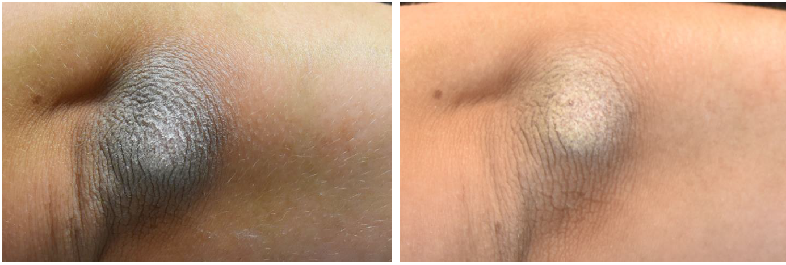
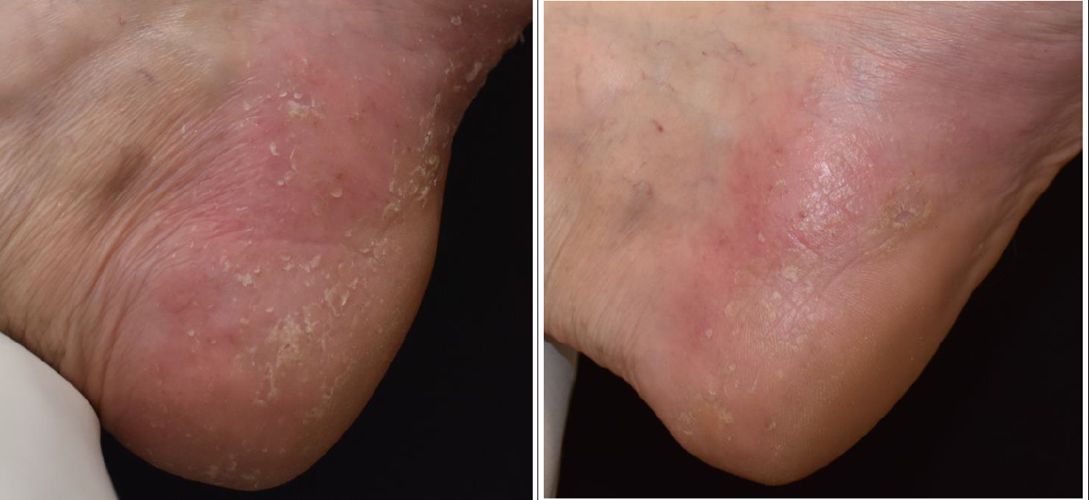
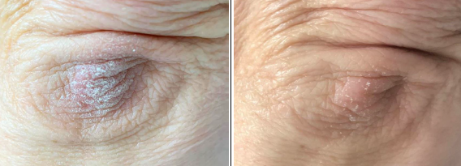
.
Efficacy of cream containing pale ichthyol, juniper berry oil and canola oil on skin microbiota in patients with psoriasis.
32-th EADV Congres Berlin, 11- 14.10.2023
Bożena Tyszczuk, Iwona Zyglińska, Monika Pasikowska-Piwko, Renata Dębowska, Katarzyna Rogiewicz, Irena Eris
Dr Irena Eris S.A., Center for Science and Research, Piaseczno, Poland
Introduction
Methods
Psoriasis is a common chronic and recurrent skin disease that can have a considerable impact on patient’s quality of life. Management of psoriasis involves intense pharmacotherapy during flare-ups, and suitable skin care to minimize the symptoms and extend remission period. Factors that can exacerbate the course of disease are infections, i.e. bacterial (S. aureus or S. pyogenes), viral (human papilloma virus and endogenous retroviruses), fungal (Malassezia spp. and Candida albicans) and parasitic. We performed Clinical trial of the cream no. 1464 (containing pale ichthyol, juniper berry and canola oils as well as shea butter) dedicated for patients with psoriasis, including microbiological study to check biodiversity of skin microbiota.
Clinical trial
Clinical trial was performed in a group of 20 adults (aged 24-69) with mild to moderate psoriasis. Dermatologist evaluation of the skin condition including psoriasis lesions (thickness/keratinization of the cuticle, exfoliation) was based on the analogue scale (0- no visible clinical symphtoms, 4- very strong sympthoms). The assessment of itch level was performed according to Numeric Rating Scale (0-lack of ich, 5- very intensive). After 4 weeks of product usage patients completed a satisfaction questionnaire.
Microbiota analysis
Microbiological study was performed in a group of 10 volunteers with visible psoriatic lesions or in remission period according to ISO 11133. The swabs were collected before and after 4 weeks of product usage from that same lesion/ place. Identification of microorganisms was carried out using RapID ONE, STAPH, CB, STR, NF, ANA (Oxoid), API 50CHB biochemical tests (BioMerieux).
Results – microbiota analysis and clinical evaluation of skin condition
D0 D28
D0 D28
47,0
35,0
-26%
Figure 2.
Figure 3. Psoriasis lesions before (D0) and after the treatment (D28).
Figure 2. Clinical assessment of the psoriatic lesions taken after 4 weeks of cream usage. According to 5- point scale (0- no visible clinical symphtoms, 4- very strong sympthoms) a decrease in scaling of psoriatic lesions by 47%, thickness by 31%, and redness by 36% was noticed. According to Numeric Rating Scale (0-lack of ich, 5- very intensive) the itching was reduced by 74%. {*} p=0,0051; {**} p=0,0284; {***} p=0,0033; [****] p=0,0015. Dermatological examination also showed high skin tolerance of the tested cream.
Figure 1. Patients self-assessment taken after 4 weeks of cream usage.
All patients confirmed, that the tested cream soothed itchy skin, supported skin regeneration and softened psoriatic lesions as well as reduced skin redness.
Moreover it had gentle anesthetic effect in opinion of all patients and cooling effect (84%). Product consistency allows application without friction. No adverse reaction was observed.
Table 1. Microbiota analysis taken from psoriatic lesions. Commensal microorganisms were marked with green colour. Results presented for selected 5 patients.
After applying the cream no. 1464A more than 50% tested samples revealed higher percentage of commensal microbiota from all isolated microorganisms. Thus suggested that product no.1464A supported the commensal skin microbiota. The pathogenic microorganisms were not observed..
Conclusion
Cream no. 1464 containing pale ichthyol, juniper berry oil and canola oil was efficacious and well tolerated in adult patients with mild to moderate psoriasis lesions. The obtained results demonstrate that systematic application of the tested cream supports the commensal microbiota of the skin, reduced psoriasis symptoms and could extend the remission phase. It can be used as regular skin care to minimize the psoriatic symptoms and prevents recurrence of lesions.

